Slide 1
Sample 1

Slide 2


Drug Delivery : Where Science meets Business
Janet Halliday / FPharmS, PhD
Associate Vice President

Slide 3
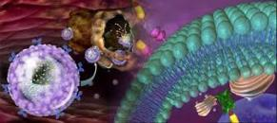
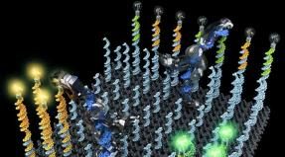
Table of Contents
Introduction to Ferring
Drug Delivery Space
Past , present and future
Business Aspects of India market
Ferring - Future

Slide 4

Ferring TODAY
Ferring TODAY
Development work with innovation partners
TLA
GLYPHARMA
Karolinska
01
MetaboGen
Innovative ideas within TA
ALRISE
Chinese Academy of Sciences
ARECOR
02
Opportunities to complement pipeline
Technische Universität Darmstadt
ASTELLAS
Intralytix
Pasteur institute
Roche
Seikagaku
03
Opportunities to broaden geography and reach
MSD
Ligand
CTCBio
Aché
The listing shown is not complete – Ferring has many additional collaborations around the globe
4
Notes:
Ferring collaborates extensively to bring diverse technologies to deliver its drugs. Building on the science to grows its business.

Slide 5
Ferring TODAY
Ferring TODAY
Ferring investment in drug delivery technologies
Since the last CRS India meeting in:
Nanotechnology laboratory opened
Ferring Institute of Reproductive Medicine collaboration
Microencapsulation laboratory at Chinese Academy of Science
Ferring Innovation Brazil laboratories opened
Ache collaboration on nanotechnology
Collaboration established with Mendeleev University
India
Brazil
China
Russia
5
Notes:
Since our now President of Ferring spoke to this meeting 12 months ago Ferring has opened new laboratories.
in
Brazil: ​development of local products in Brazil as well as the set-up of the new nanotechnology laboratory in collaboration with Achè.
Mendeleev: development of nasal formulations for biopharmaceuticals, starting with peptide drugs.
IPC-I: Nanotechnology laboratory. Continuing the development of local products in India based on established technologies at IPC India as well as identifying local opportunities for innovative technologies that can be applied to development of global products.
China: development of long-acting formulations for biopharmaceuticals, in particular, starting with microsphere drug delivery system for peptide drugs.

Slide 6
Ferring TODAY
Ferring TOMORROW
The new Ferring R&D center
Copenhagen opening 2020
Ferring invests heavily
in the process of creating new medicines through
R&D and Research collaborations
6
Notes:
Since our now President of Ferring spoke to this meeting 12 months ago Ferring has opened new laboratories.
in
Brazil: ​development of local products in Brazil as well as the set-up of the new nanotechnology laboratory in collaboration with Achè.
Mendeleev: development of nasal formulations for biopharmaceuticals, starting with peptide drugs.
IPC-I: Nanotechnology laboratory. Continuing the development of local products in India based on established technologies at IPC India as well as identifying local opportunities for innovative technologies that can be applied to development of global products.
China: development of long-acting formulations for biopharmaceuticals, in particular, starting with microsphere drug delivery system for peptide drugs.

Slide 7
Sample 2

Slide 8
Sample 2

Slide 9
SPIRIT PRESENTATION TO

Slide 10
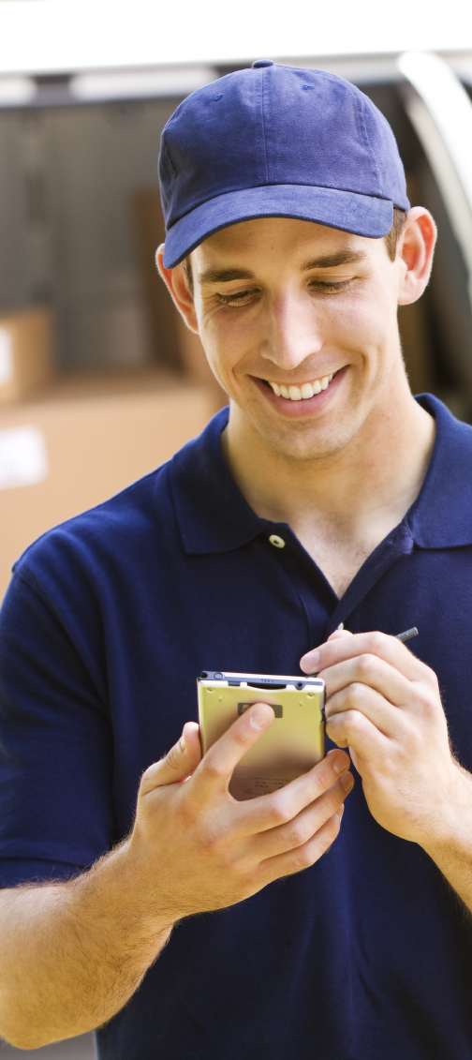
Spirit overview
          Spirit is an enterprise mobility solution specialist. Our company was created to:
          Develop individual and end-to-end solutions
          Provide a fully-managed service and a software development service
          Focus on customer care
Notes:
We design, implement and support enterprise mobility solutions so that you can focus on running your business
We offer a fully managed service and software development
Our aim is to be your trusted advisor for enterprise mobility

Slide 11
We achieve this through:
Being vendor-independent
Notes:
We’re vendor independent

Slide 12
An in-depth knowledge of technologies
Having ISO 9001 and ISO27001 accreditations
Notes:
We have a thorough understanding of leading-edge mobile and data capture technologies
We’ve gained ISO9001 Quality Management System accreditation and have an ISO27001-accredited data centre

Slide 13
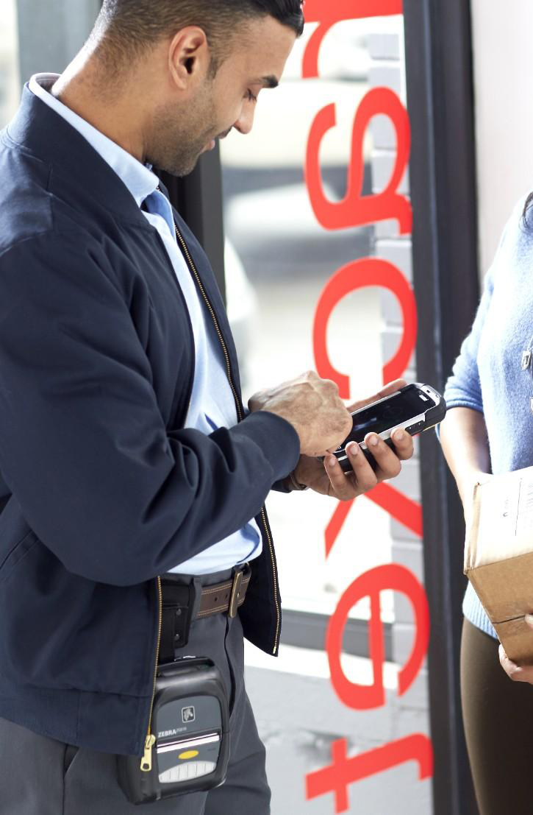
Mobile Connect - ePoD
          Overview :
          Designed for companies that deliver products
          Gives accurate proof of delivery and collection in real time
          You can therefore invoice your customers quickly and with confidence
          Reduces human error and enables you to resolve invoice disputes
          Integrates with your existing systems
Notes:
ePoD comes into force once your van is loaded with items for delivery.

Slide 14
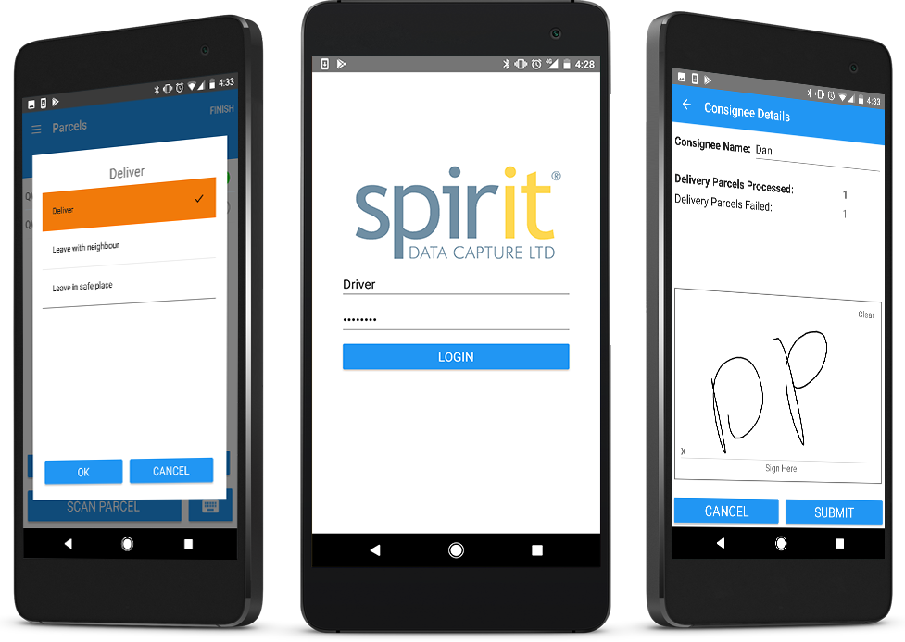
Mobile Connect - ePod in the Last Mile
          Key features :
          Key benefits :
          Integration with distributor’s systems
          Real-time data transfer
          Collections
          Flexibility
          Scalability
Notes:
ePoD comes into force once your van is loaded with items for delivery.

Slide 15
Sample 3

Slide 16


Grease, Smoke & Odour Control
Controlling emissions
from commercial cooking processes
A seminar by Purified Air Ltd.

Slide 17


Agenda
An Introduction to Purified Air
The DEFRA Guide and how it is applied
What is needed between the canopy and the fan
What can be in a commercial kitchen exhaust and how best to filter / control it
  Electrostatic Precipitation
  Carbon Filtration
  UV-C Technology
  The ON100
Specifying A Control System
Any Other Questions?

Slide 18


The Family Owned Company With The Global Reach
UAE
Egypt
Saudi Arabia
Qatar
Jordan
Lebanon
Kuwait
Oman
Portugal
Holland
Germany
Serbia
Austria
Slovakia
Czech Republic
Slovenia
Korea
Turkey
Poland
Ireland
Spain
Malta
Pakistan
Italy
Gibraltar
Romania

Slide 19

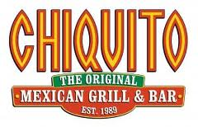








Some of
Our Better Known Customers

Slide 20

The DEFRA Guide
Guidance on the Control of Odour and Noise from Commercial Kitchen Exhaust Systems published January 2005
Applies to both new and existing premises for particulate filtration and odour control
Purified Air’s Managing Director, David Collins, was consulted during the compilation of this report and is referenced in chapter 6 “Acknowledgement” for his technical assistance

