Slide 1
Sample 1

Slide 2
Innovation in Pharmaceutical Development
Making ideas into products
Notes:
By innovation we mean ‘The process of translating an idea or invention into a product or service that creates value or an improvement in adherence, safety or efficacy.’
Good ideas are not enough, they must be converted into something that adds value to the business. One way of measuring innovation is looking at the Patent Applications that are made. The patent process encompasses the conversion of the a NOVEL idea into a something that can be USEFUL, that no one else has done before

Slide 3
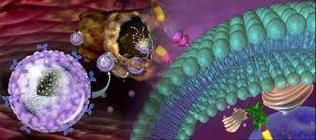
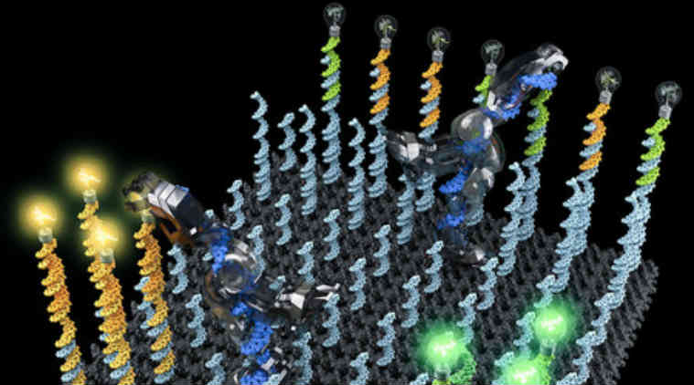
Introduction
Drug Delivery Space
Past , present and future
Business Aspects of India market
Ferring - future

Slide 4
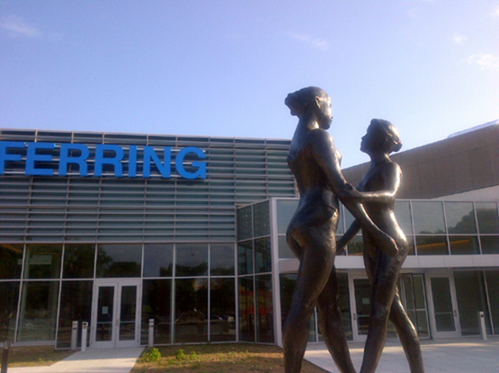
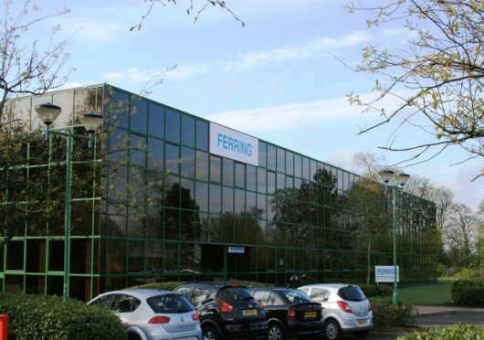
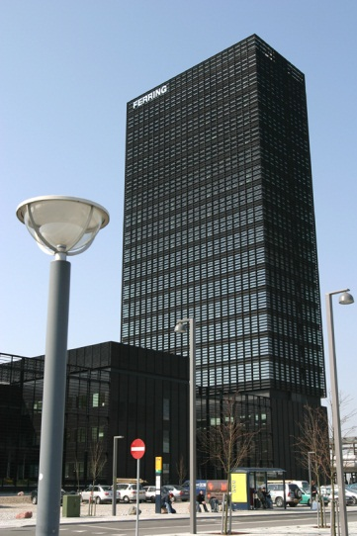
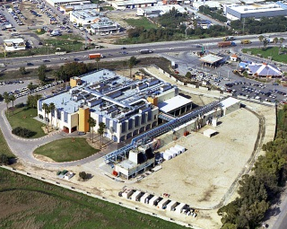
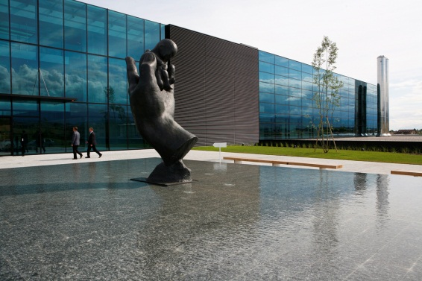
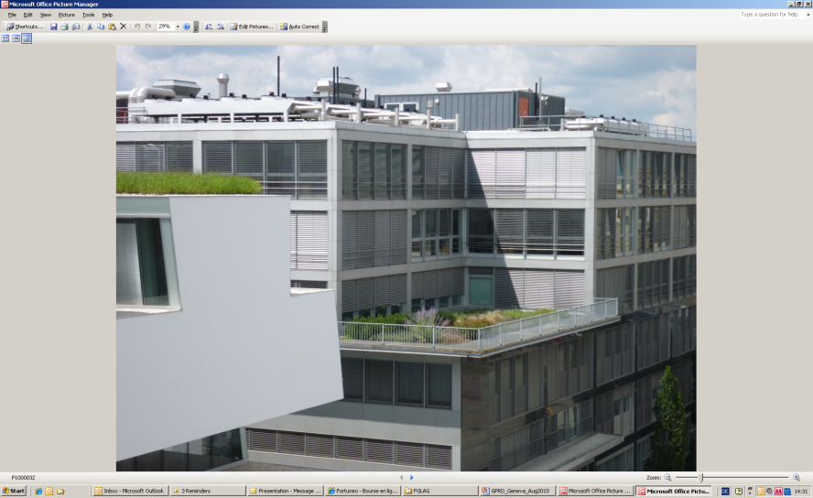
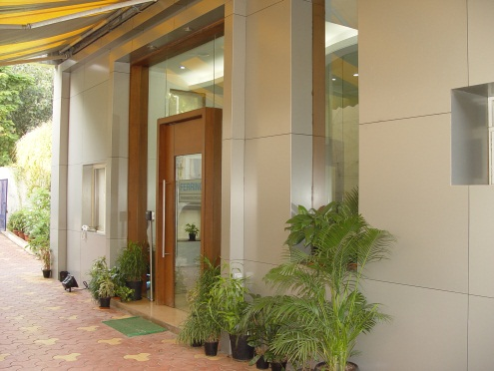

GPRD Geographical locations
FCT, Scotland
FIPCUS
IPC Denmark
CMC Support to F-Japan, F-China
BTG, Israel
FICSA Switzerland
FGLAG, Switzerland
IPC India
Notes:
Pharmaceutical Research and Development is located globally across Ferring, the newly established site in the US adds to those in Europe and India, support to Asia is an increasing commitment.

Slide 5
Ferring investment in drug delivery technologies
Since the last CRS India meeting in:
  Brazil
    Ferring Innovation Brazil laboratories opened
    Ache collaboration on nanotechnology
  Russia – collaboration established with Mendeleev University
  India - nanotechnology laboratory opened
  China
    Ferring Institute of Reproductive Medicine collaboration
    microencapsulation laboratory at Chinese Academy of Science
Notes:
Since our now President of Ferring spoke to this meeting 12 months ago Ferring has opened new laboratories.
in
Brazil: ​development of local products in Brazil as well as the set-up of the new nanotechnology laboratory in collaboration with Achè.
Mendeleev: development of nasal formulations for biopharmaceuticals, starting with peptide drugs.
IPC-I: Nanotechnology laboratory. Continuing the development of local products in India based on established technologies at IPC India as well as identifying local opportunities for innovative technologies that can be applied to development of global products.
China: development of long-acting formulations for biopharmaceuticals, in particular, starting with microsphere drug delivery system for peptide drugs.

Slide 6
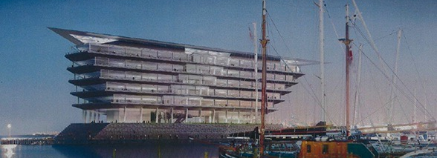
Ferring TOMORROW
The new Ferring R&D center
Copenhagen opening 2020
Ferring invests heavily
in the process of creating new medicines through
R&D and Research collaborations
6

Slide 7
Sample 2

Slide 8

Spirit presentation to
Menzies Distribution

Slide 9

Spirit’s managed services
  Key features:
An end-to-end support package
Access to highly trained experts
A unique and highly personalised service
Bespoke or out-of-the-box offering
Complete management of third parties and manufacturers
Notes:
Our managed services include an end-to-end support package covering every aspect of a mobility solution
Access to highly trained mobility experts
A unique and highly personalised and a unique service offering
With a choice of offerings
And complete management of third parties and manufacturers

Slide 10
Company profile
We’re established
We’re committed
We’re experienced
Notes:
Our managed services include an end-to-end support package covering every aspect of a mobility solution
Access to highly trained mobility experts
A unique and highly personalised and a unique service offering
With a choice of offerings
And complete management of third parties and manufacturers

Slide 11
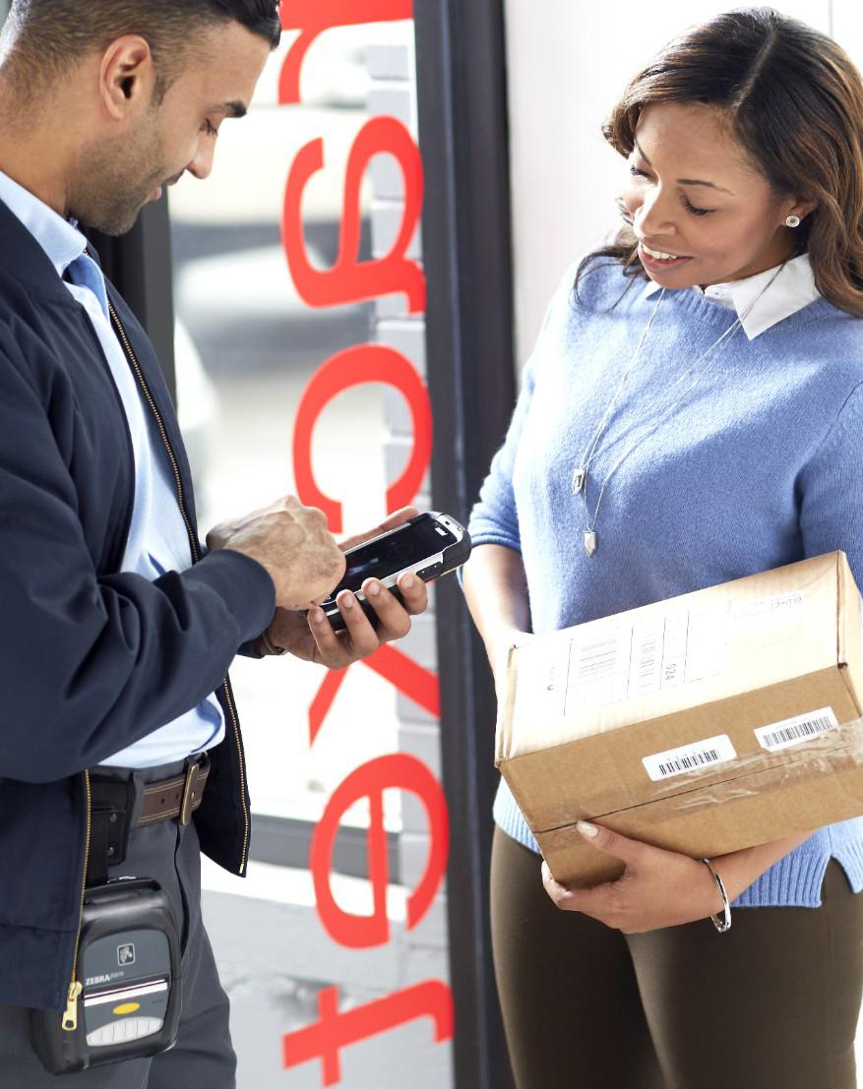
Mobile Connect - ePoD
  Overview:
  Designed for companies that deliver products
  Gives accurate proof of delivery and collection in real time
  You can therefore invoice your
  customers quickly and with confidence
  Reduces human error and enables you
  to resolve invoice disputes
  Integrates with your existing systems
Notes:
Our managed services include an end-to-end support package covering every aspect of a mobility solution
Access to highly trained mobility experts
A unique and highly personalised and a unique service offering
With a choice of offerings
And complete management of third parties and manufacturers

Slide 12
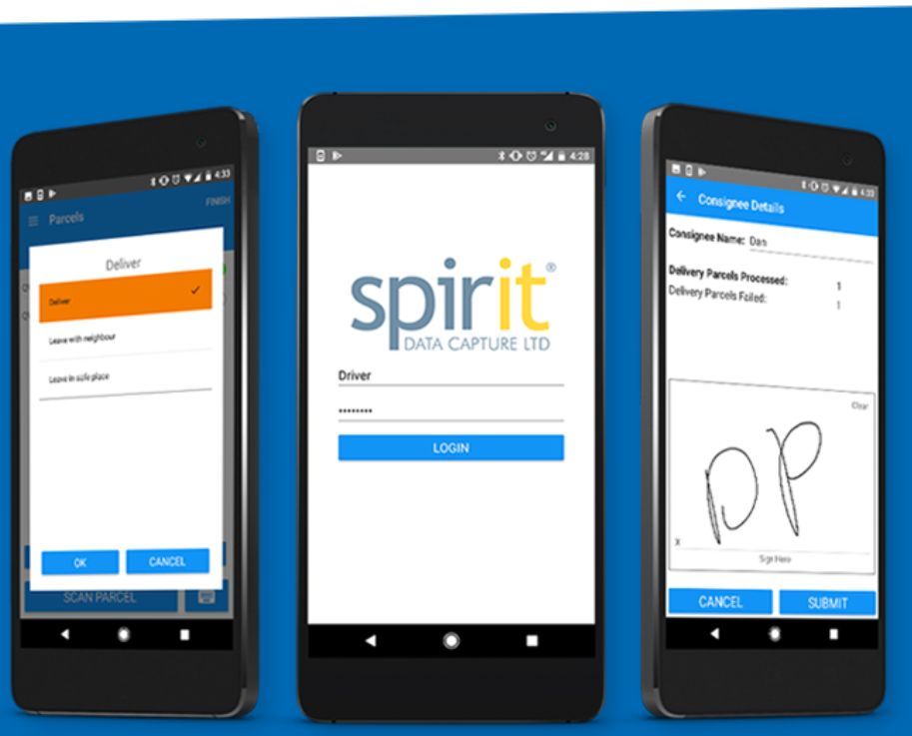
Mobile Connect - ePod in the Last Mile
  Key features
  Integration with distributor’s systems
  Real-time data transfer
  Collections
  Key benefits
  Flexibility
  Scalability
Notes:
Our managed services include an end-to-end support package covering every aspect of a mobility solution
Access to highly trained mobility experts
A unique and highly personalised and a unique service offering
With a choice of offerings
And complete management of third parties and manufacturers

Slide 13
Sample 3

Slide 14

Grease, Smoke
& Odour Control
Controlling emissions
from commercial cooking processes
A seminar by Purified Air Ltd.

Slide 15

AGENDA
An Introduction to Purified Air
The DEFRA Guide and how it is applied
What is needed between the canopy and the fan
What can be in a commercial kitchen exhaust and how best to filter / control it:
  Electrostatic Precipitation
  Carbon Filtration
  UV-C Technology
  The ON100
Specifying A Control System
Any Other Questions?
The Dubai Mall

Slide 16
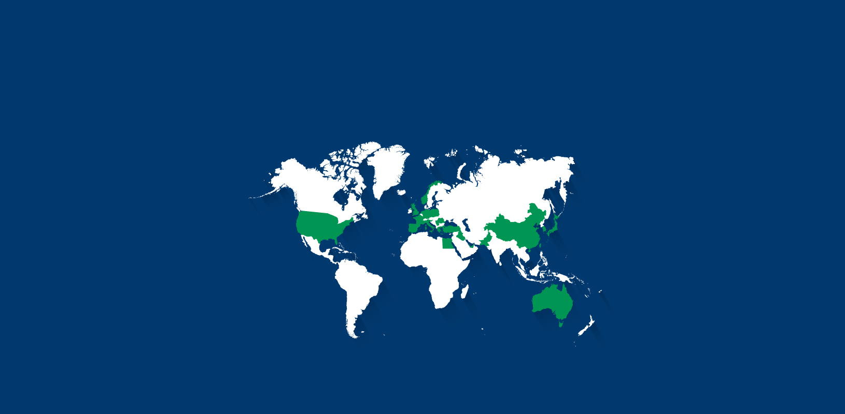
PURIFIED AIR
The Family Owned Company With The Global Reach
United Kingdom
UAE
Egypt
Saudi Arabia
Qatar
Jordan
Lebanon
Kuwait
Oman
Portugal
Holland
Germany
Serbia
Austria
Slovakia
Czech Republic
Slovenia
Korea
Turkey
Poland
Ireland
Spain
Malta
Pakistan
Italy
Gibraltar
Romania

Slide 17












Some of
Our Better Known Customers

Slide 18
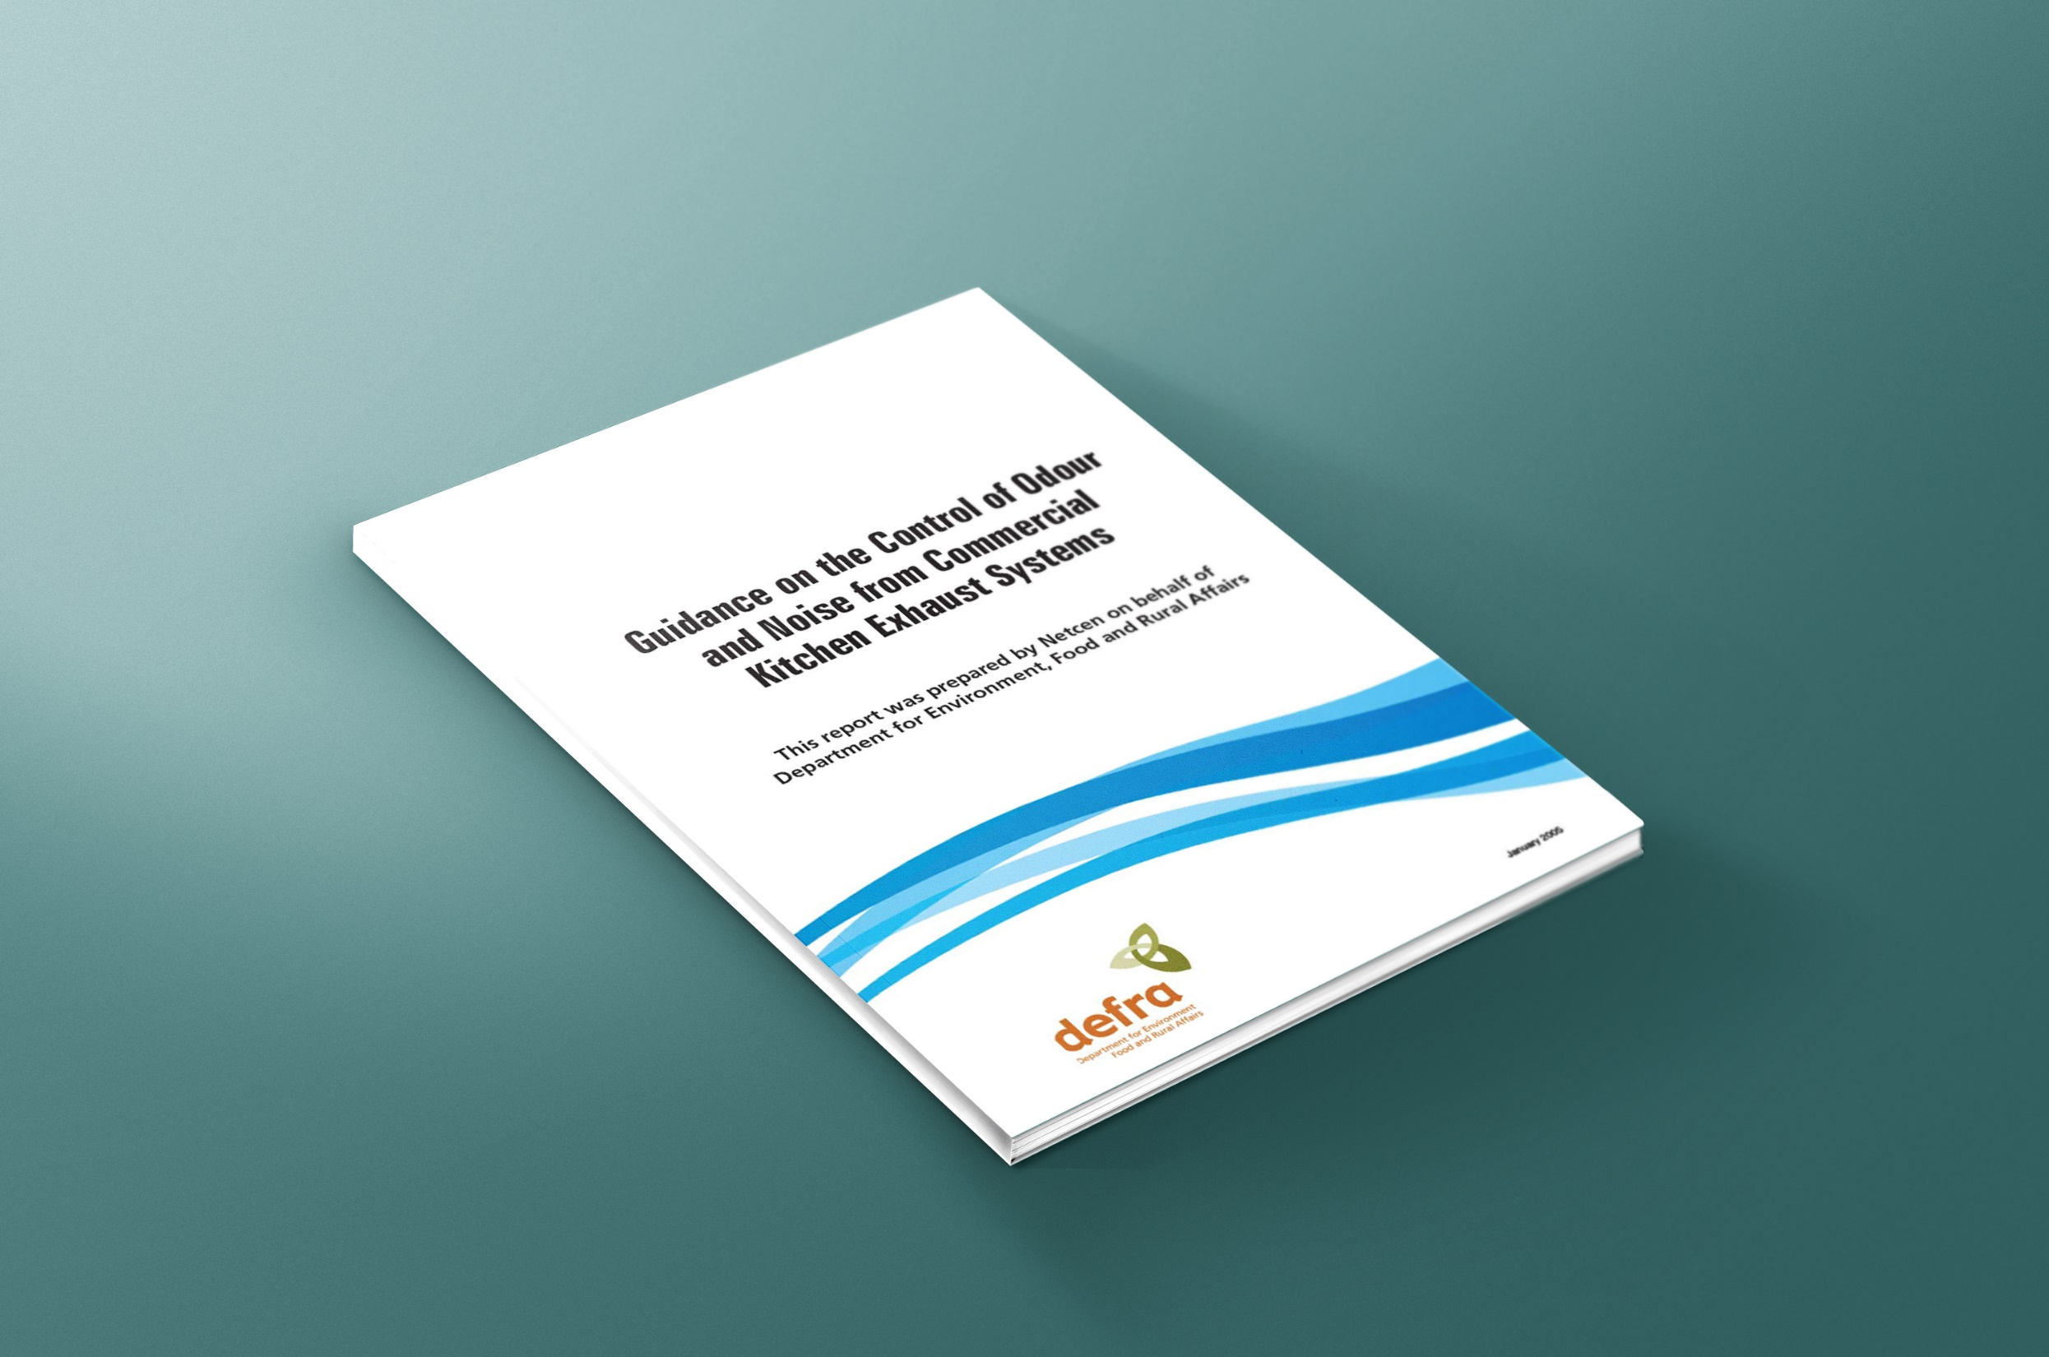
The DEFRA Guide
Guidance on the Control of Odour and Noise from Commercial Kitchen Exhaust Systems published January 2005
Applies to both new and existing premises for particulate filtration and odour control
Purified Air’s Managing Director, David Collins, was consulted during the compilation of
this report and is referenced in chapter 6 “Acknowledgement” for his technical assistance.

